Slide 1
Mini Project……………….. Calculator………………..
Presented By- Presented To-
Name: Roli Verma Assistant Professor
Branch/Year: CSE 2nd year Mohd. Shahanawaz
ROLL NO: LE-05 Department-CSE

Slide 2
Contents
Introduction
Requirements
Technology used in this project
Objectives of the project
Screenshot of output
Future Scope of the Project
References
Conclusion

Slide 3
Introduction
The introduction to the mini project calculator using HTML, CSS, and JavaScript is :
We will create a simple calculator that allows users to perform basic arithmetic operations like addition, subtraction, multiplication, and division. We'll use HTML for structure, CSS for styling, and JavaScript for functionality..

Slide 4
Requirements
1. Software Requirements
A web browser (Chrome, Edge, Firefox, etc.)
Code editor (VS Code / Sublime Text / Notepad++)
Operating system: Windows / Linux / macOS
2. Technologies Required
HTML — for creating the calculator layout
CSS — for styling the board and UI
JavaScript — for calculator logic and interactions
3. Hardware Requirements
Any desktop or laptop
Minimum 2GB RAM
Internet not required
4. Functional Requirements
Calculator Design
Arithematic operation

Slide 5
Technology used in this project
1. HTML (Hyper Text Markup Language)
Used to create the structure of the calculator
Defines the 3×3 grid and buttons
Provides the basic layout of the webpage
2. CSS (Cascading Style Sheets)
Used to style the calculator
Provides colors, layout, spacing, and responsiveness
Makes the UI attractive and user-friendly
3. JavaScript
Controls the calculator logic
Handles calculator
Checks win conditions and draw
Updates the UI dynamically
Provides the restart functionality
4. Web Browser
Game works in Chrome, Edge, Firefox etc.

Slide 6
Objectives of the project
To develop a simple and interactive Calculator using HTML, CSS, and JavaScript.
To understand how web pages work using basic front-end technologies.
To learn DOM manipulation and event handling in JavaScript.
To design a clean and user-friendly interface using CSS.
To provide a fully functional browser-based
To enhance logical thinking and problem-solving through aap development.

Slide 7
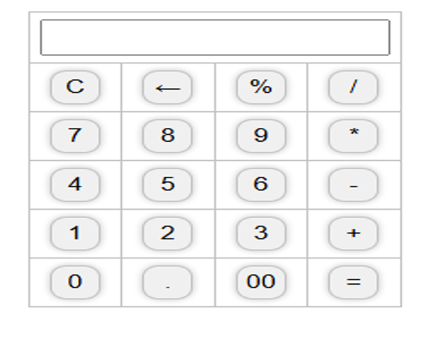
Screenshot of output

Slide 8
Future Scope of the Project
1. Advanced Mathematical Operations- Implement trigonometric functions (sin, cos, tan, etc.)- Add logarithmic and exponential functions- Incorporate statistical and scientific calculations
2. Multi-Language Support- Translate the calculator interface into multiple languages- Allow users to switch between languages seamlessly
3. Unit Conversion- Integrate unit conversion capabilities (length, weight, temperature, etc.)- Enable users to convert between different units
4. Graphing Capabilities- Develop a graphing feature to visualize mathematical functions- Allow users to plot and analyze graphs
5. Mobile App Development- Create mobile apps for Android and iOS platforms- Optimize the calculator for mobile devices

Slide 9
References
W3Schools – HTML, CSS, and JavaScript basics
Online tutorials and articles for calculator logic
YouTube videos for front-end development concepts
Classroom notes and teacher guidance
Personal understanding and practice while building the project

Slide 10
Conclusion
The calculator project is a fundamental tool that has been successfully designed and developed to perform basic arithmetic operations. The project has met its objectives, providing a user-friendly interface and accurate calculations.
Key Achievements:- Developed a functional calculator with basic arithmetic operations- Implemented a clean and intuitive user interface- Ensured accurate calculations and error handling
Future Enhancements:- Advanced mathematical operations (trigonometry, logarithms, etc.)- Multi-language support- Unit conversion capabilities- Graphing features- Mobile app development.

Slide 11
Thank You

